Slide 1
Introduction to AI
Tuomas Sandholm
Professor
Carnegie Mellon University
Computer Science Department

Slide 10
History of AI and AI today

Slide 12
Other attendees were Ray Solomonoff, Oliver Selfridge, Trenchard More, Arthur Samuel, Herbert A. Simon, and Allen Newell

Slide 13
-> A* algorithm

Slide 17
2015-2017 – superhuman speech understanding

Slide 19
[Sandholm et al.]

Slide 21
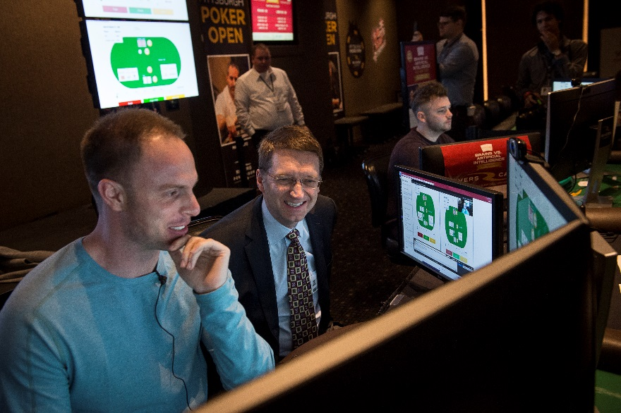
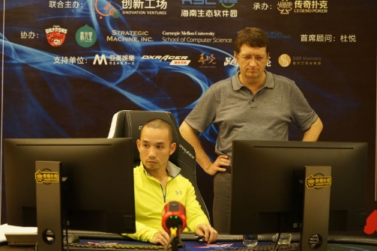
Superhuman strategic reasoning under imperfect information
Libratus beats best humans at heads-up no-limit Texas hold’em poker [Brown & Sandholm]
Pittsburgh, January 2017
Haikou, April 2017

Slide 22
Highly parallel / distributed
Driving trends
Moore’s law ended 2004 => to continue progress, need highly multi-core
Software-as-a-Service & clouds
Access to large-scale resources
Affordable due to amortization across bursty users
Big data

Slide 23
Thoughts about goals of AI
AI has many different goals
This is nothing to avoid
E.g., OR has same “problem” and is not shy about it
Shouldn’t define AI as that which still cannot be done
Human-level intelligence just a milestone along the way
Q: Will there be a super-human species? A: No, AIs will be tools for various purposes

Slide 24
Some potential new AI applications with huge positive impact on the world
Better electricity markets
Combinatorial CO₂ allowance / pollution credit markets
Automated market making
Campaign market for advertising
Security games
Physical, information, malware protection, …
Sequential

Slide 25
AI in medicine (and biology)
Machine learning from data
E.g., DNA sequencing data will be driving this
Active learning
AI not just for understanding but for control… [Sandholm, AAAI Conference on Artificial Intelligence, 2015]

Slide 26
AI is a fast-moving exciting area
We can directly make the world a better place

